Slide 1

Biomedical Informatics
Week 4 Workshop

Slide 2
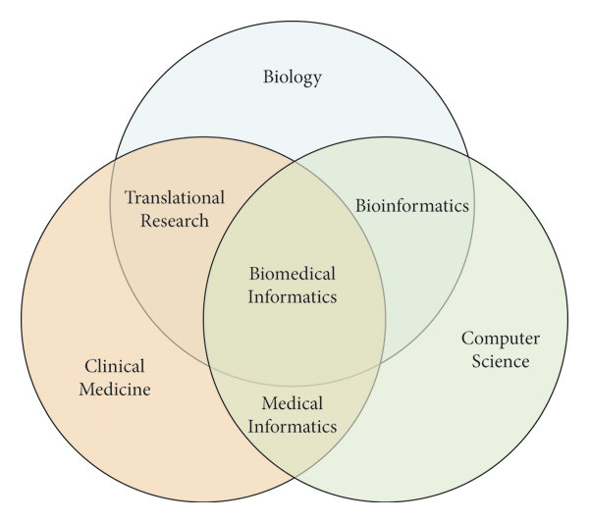
What is biomedical informatics?
Notes:
Field that intersects biology, medicine, computer science, and data. Using informatics/information to help diagnose, inform, and aid physician health

Slide 3
Biomedical informatics is made up of various subfields
Public Health Informatics
Disease Identification
Imaging Informatics
Physician Well-being
Bioinformatics
Treatment Optimization
Clinical Informatics
Clinical Decision Support
Notes:
Four subfields:
Public health informatics
Society as a whole, preparing for bioterrorist attacks
Imaging informatics
Tissues and organs, advancing applications like scanners that create 3d images
Bioinformatics
molecular/cellular processes, like with sequencing and sequencing data
Clinical informatics
Patient-based
Focused on collecting/managing/storing patient data/electronic records
We will be focusing on this today with sepsis (done at UCSD!)
Main applications:
Disease Identification - the dream
Detect diseases early using algorithms on patient data.
Physician Well-being
Track burnout, workflow, mental health via system usage patterns.
Treatment Optimization
Personalize care plans based on past outcomes.
Clinical Decision Support - most common rn - helping with alerting physicians rather than diagnosing
Help doctors make evidence-backed choices.

Slide 4
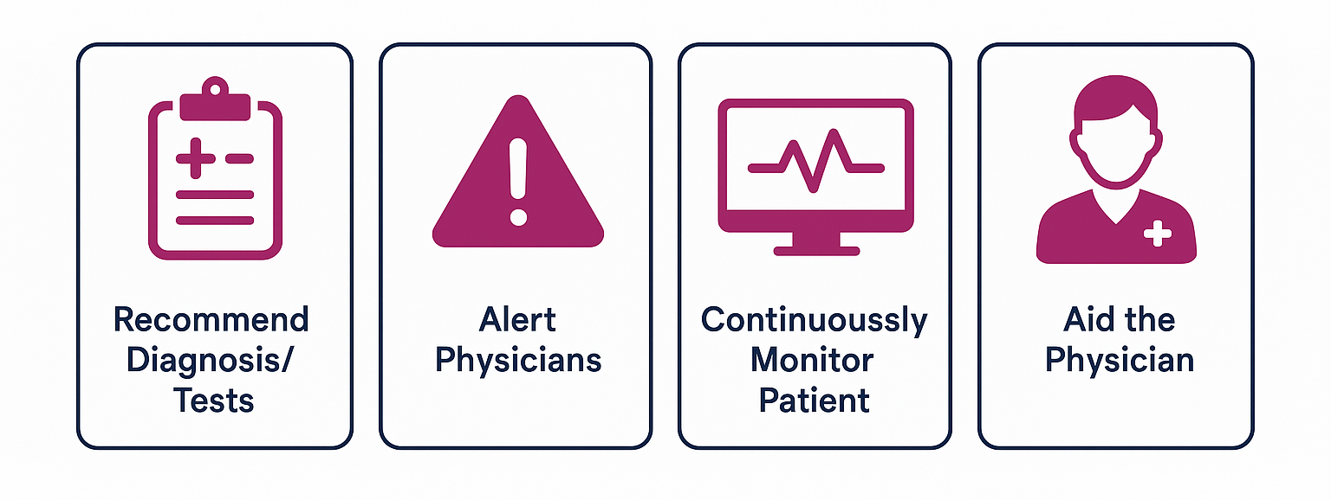
Physicians use clinical biomedical informatics as a tool, not a replacement
Recommend Diagnosis/
Tests
Alert Physicians
Continuously Monitor Patient
Aid Physicians
Notes:
Clinical Biomedical Informatics can help physicians in many ways, depending on the situation
Recommend a diagnosis or tests
Alert physicians that a certain outcome is likely/high risk (like with sepsis, which we’ll work with today)
Continuously monitor the patient
Most important: does not replace the physician, just aids

Slide 5
Clinical biomedical informatics is becoming more common due to more Electronic Health Record (EHR) data
6.6%
88.2%
of offices use EHRs in 2009
of offices use EHRs in 2021
Notes:
Biomedical informatics is becoming more common because of the introduction of online hospital data systems for electronic health records (EHRs)
Systems such as EPIC, Cerner (Oracle Health), and Meditech
Hospitals are generating massive amounts of patient data—not just patient history but also lab test, imaging, clinical notes, etc.
EHR systems have standardized and centralized this data, making it easier to work with
However, systems from hospital to hospital are different and thus might have to be analyzed differently
More data means AI/ML can work well, as there are more patterns to find
Additionally, with this access of personal health data comes the issue of protecting this private data
Still being debated as it’s necessary to give this data but it comes with its own problems regarding security and HIPAA

Slide 6
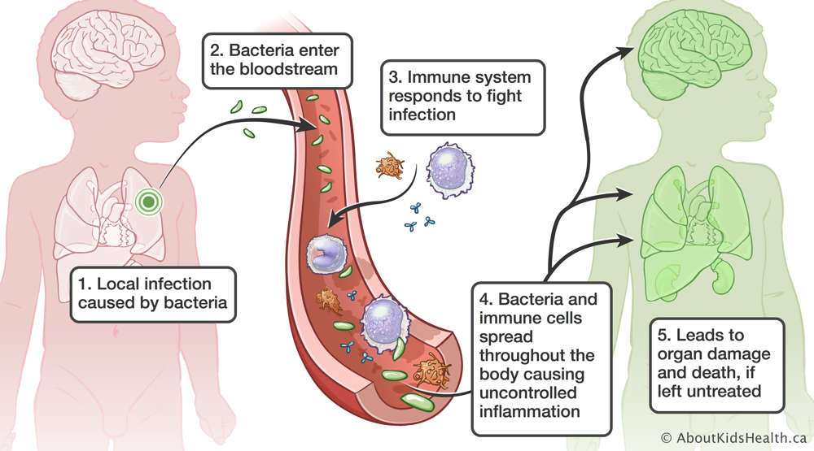
Sepsis is an overreaction of the body’s immune system
Improper bodily response to an infection
Can cause organ failure
200,000+ cases per year
Notes:
Symptoms - fever, chills, high heart rate, disorientedness

Slide 7
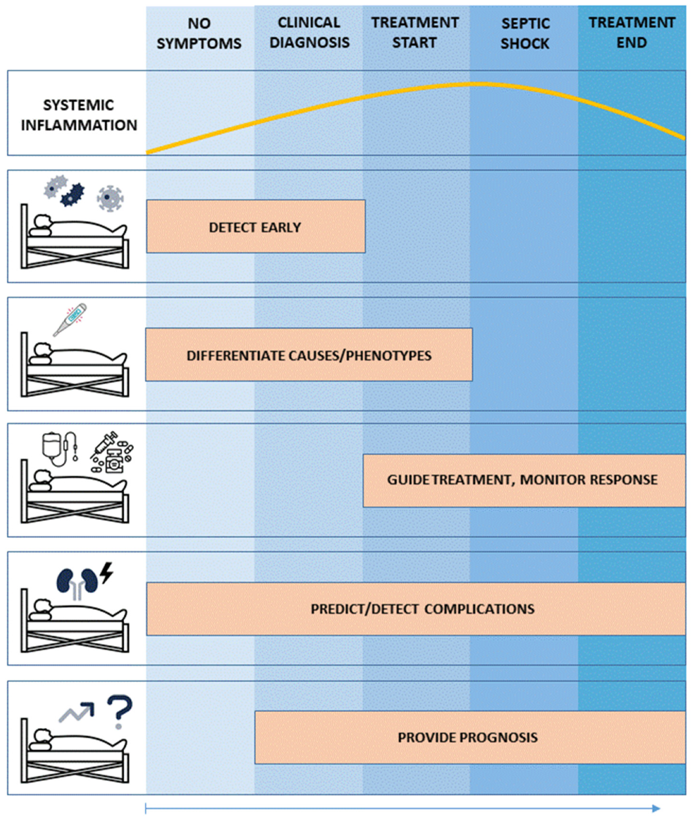
Sepsis treatment is extremely time sensitive
Must be treated ASAP, via antibiotics
Patients can either make a full recovery or could die
Thus, implementing a successful program to predict risk of sepsis could save lives
Notes:
Current Treatment + how AI / ML model ties into that

Slide 8

Blatant Percentages can lead to Physician Fatigue
Notes:
Requires Medical Trials, just as different medicines require testing
Issue - Should not just show a blatant percentage → physician fatigue
Want to train the models, giving them feedback
Could categorize patients into high or low risk

Slide 9
67%
of sepsis patients were not categorized as high risk.
Notes:
Alerting a physician doesn’t lead to the proper treatment always.
7% of hospitalized high risk patients did not receive timely antibiotics
The model doesn’t catch all cases. It also catches many false positives
Failed to identify 67% of sepsis patients
18% False Positives

Slide 10

EHR trained models don’t generalize between hospitals
AUC Data
EPIC: 0.76 - 0.83
Actual: 0.6
Notes:
https://jamanetwork.com/journals/jamainternalmedicine/fullarticle/2781307?utm_source=substack&utm_medium=email
Not for diagnosis but rather alerting physicians about it
Sepsis is a leading cause of death
Once one hospital implemented a program written by another group, they found that it wasn’t accurate - it showe that the algorithm was close to just guessing
Epic sepsis model failure
Absolutely. So I think back in 2016/2017, Epic came up with a system that would help healthcare providers predict which patients are most at risk of sepsis. And I think, again, this is a very important problem. I think sepsis is one of the leading causes of death worldwide and even in the US. And so, if we could fix that, I think it would be a game changer. The problem was that there were no external validations of this algorithm for the next four years. So for four years, between 2017 to 2021, the algorithm wasn't used by hundreds of hospitals in the US. And in 2021, a team from University of Michigan did this study in their own hospital to see what the efficacy of the sepsis prediction model is. They found out that Epic had claimed an AUC of between 0.76 and 0.83, and the actual AUC was closer to 0.6, and AUC of 0.5 is making guesses at random.
So this was much, much worse than the company's claims. And I think even after that, it still took a year for sepsis to roll back this algorithm.
Epic was incentivizing the use of the model too. Capitalism

Slide 11
Medical Informatics @ UCSD
Different PhD Programs - BISB / Medical Informatics
Sepsis Model was generated at UCSD! (Nemati Lab)
Model - https://health.ucsd.edu/news/press-releases/2024-01-23-study-ai-surveillance-tool-successfully-helps-to-predict-sepsis-saves-lives/
Paper - https://www.nature.com/articles/s41746-023-00986-6
Cool projects at UCSD (among many!)
iAgree Project - Decentralizing EHR Data Records
SureNet - Ensuring patients receive follow-up care as instructed
Curtius Lab
Check out https://dbmi.ucsd.edu for more info

